Slide 1

Object Oriented Programming
Nabeela Ashraf
Department of Computer Science
UAF

Slide 2
C++: Basics
LECTURE OUTLINE
Static Memory Allocation
Dynamic Memory Allocation
Pointers and 2D Arrays

Slide 3

C++: Concepts of Heap and Stack/2D Array
Static Memory Allocation (SMA)
int a=35;
int *p;
p=new int;
*p=57;
cout<<p<<endl<<*p;
delete p;
Dynamic Memory Allocation (DMA)
p=new int[4];
for(int i=0;i<4;i++)
cin>>p[i];
for(int j=0;j<4;j++)
cout<<p[j];
delete [] p;
p=NULL;

Slide 4
C++: Concepts of Heap and Stack/2D Array
Dynamic Memory Allocation (DMA): 2D Array
int rows, cols;
cout<<"Enter number of rows : ";
cin>>rows;
cout<<"Enter number of cols : ";
cin>>cols;
int **ptr;
ptr=new int*[rows];
for(int i=0;i<rows;i++)
ptr[i]=new int[cols];

Slide 5
C++: Concepts of Heap and Stack/2D Array
Dynamic Memory Allocation (DMA): 2D Array
for(int i=0;i<rows;i++)
for(int j=0;j<cols;j++)
cin>>ptr[i][j];
for(int i=0;i<rows;i++){
for(int j=0;j<cols;j++)
cout<<setw(3)<<ptr[i][j];
cout<<endl;
}

Slide 6
C++: Concepts of Heap and Stack/2D Array
Dynamic Memory Allocation (DMA): 2D Array
for(int i=0;i<rows;i++)
delete [] ptr[i];
delete [] ptr;
return 0;

Slide 7
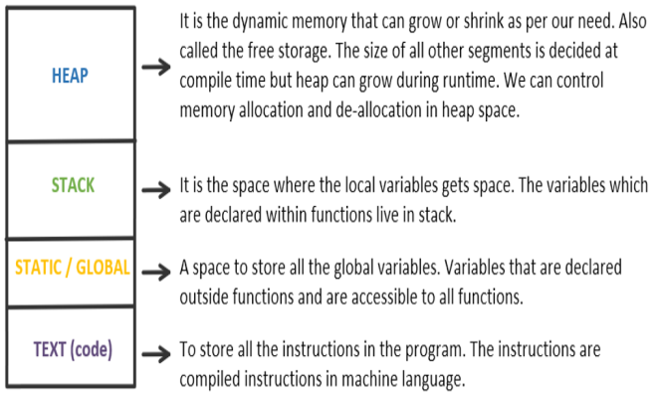
C++: Concepts of Heap and Stack/2D Array
HEAP/STACK/STATIC, GLOBAL VARIABLES, CODE SECTION

Slide 8
C++: Concepts of Heap and Stack/2D Array
STACK AND HEAP
The Stack: All variables declared inside the function will take up memory from the stack.
The Heap: This is unused memory of the program and can be used to allocate the memory dynamically when program runs.

Slide 9
C++: Concepts of Heap and Stack/2D Array
Jagged Array: Array of rows of different lengths
int rows;
cin>>rows;
int *ptr=new int[rows];
int **jArray=new int*[rows];
for(int i=0;i<rows;i++){
cout<<"Enter number of column in row "<<i<<" : ";
cin>>ptr[i];
jArray[i]=new int[ptr[i]];
}
1 | 2
1 | 3 | 5
2 | 8 | 9 | 7
1 | 9 | 9 | 8

Slide 10
C++: Concepts of Heap and Stack/2D Array
Jagged Array: Array of rows of different lengths
for(int i=0;i<rows;i++)
for(int j=0;j<ptr[i];j++)
{cout<<"Row "<<i<<" enter value "<<i*ptr[i]+j<<" : ";
cin>>jArray[i][j];}
for(int i=0;i<rows;i++){
for(int j=0;j<ptr[i];j++)
cout<<setw(3)<<jArray[i][j];
cout<<endl;
}

Slide 11

Have a Nice Day

